Slide 1
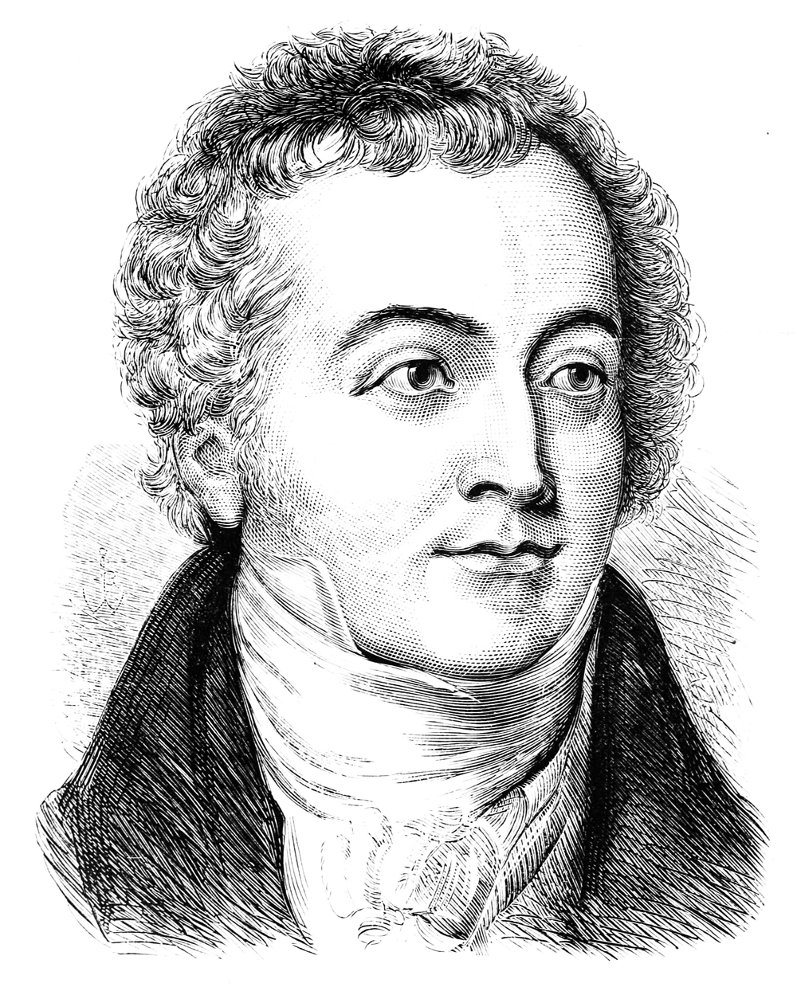
Thomas Young
Young’s double-slit experiment (1801): provided concrete evidence for the wave nature of light

Slide 2
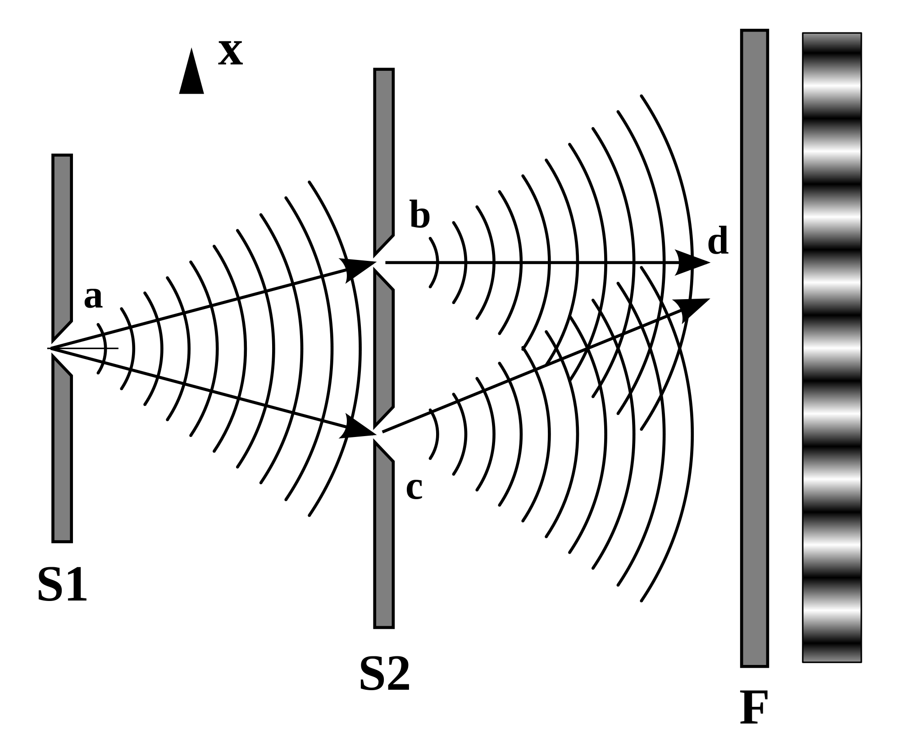
monochromatic light source
A
S
S’
B
narrow slit
double
slits
viewing
screen
observed
interference
pattern

Slide 3
frequency of wave f
Planck’s constant
A light beam is made up of a stream of massless particles called photons

Slide 4
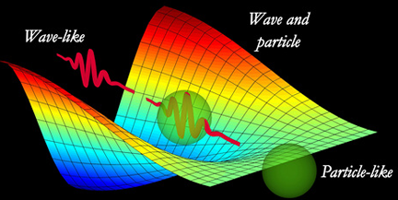

Slide 5
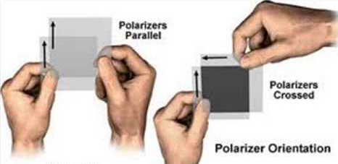
polarisers
parallel
polarisers
crossed

Slide 6
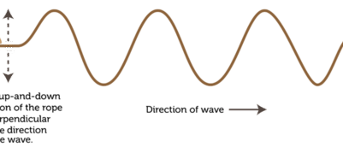

transverse wave in a string
The up-down motion of the string is perpendicular to the direction of wave propagation
direction of propagation

Slide 7
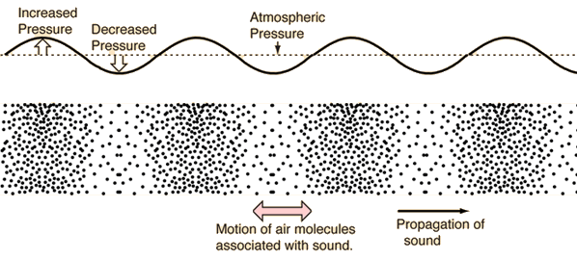
longitudinal sound wave in air
motion of air molecules
direction of propagation

Slide 8
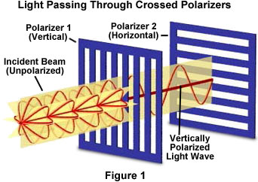

Slide 9
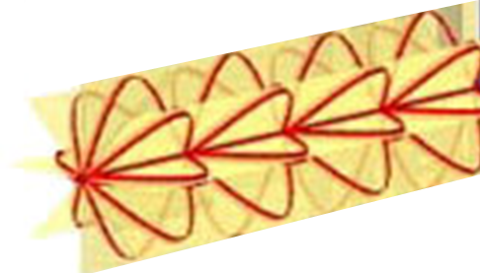
direction of propagation
unpolarised light beam

Slide 10
plane of polarisation
direction of propagation
Linearly or plane polarised light:
oscillating electric field confined to a single plane

Slide 11
conductive metal grid
zero transmission of microwaves through metal grid
incident plane polarized microwave beam
microwave energy absorbed by establishing electric currents in the metal grid

Slide 12
conductive metal grid
maximum transmission of microwaves through metal grid
incident plane polarized microwave beam
microwave energy not absorbed by the metal grid

Slide 13
Y
direction of propagation
Z
X
transmitted electric field vector is linearly polarized in the horizontal plane (XZ plane)
vertical metal wire grid
electric field vectors for unpolarised microwave mean

Slide 14
Y
Z
direction of propagation
X
X
transmitted electric field vector is linearly polarized in the horizontal plane (XZ plane)
vertical metal wire grid
electric field vector for a polarised microwave mean
only horizontal component is transmitted
vertical component absorbed

Slide 15
light intensity detected by a photocell
Y
Z
Analyser
X
X
Polariser
Polarising axis
Polarising axis
electric field vectors for unpolarised beam
transmitted by Analyser
only vertical electric field transmitted through Polariser
absorbed by Analyser

Slide 16
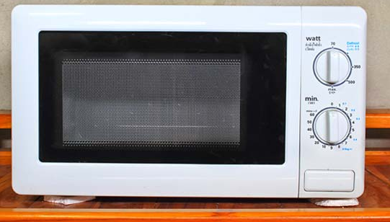
window has a metal mesh embedded in it
zero transmission through the cross metal grids

Slide 17
unpolarised incident light
polarised reflected light
(polarisation parallel to the surface)
non-metallic surface

Slide 18
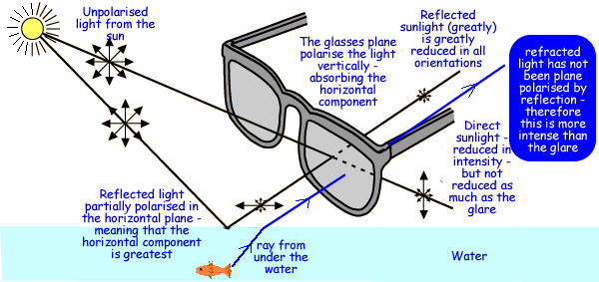
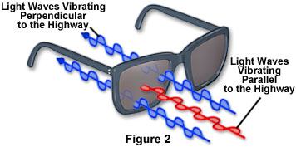
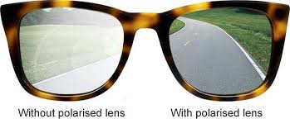

Slide 19

polaroid sunglasses transmit the vertical components of sunlight
polaroid sunglasses absorb the horizontal components of sunlight
unpolarised sunlight

Slide 20
The polaroid sunglasses have polarisers in the lens which absorb the horizontal component of the light, so reflected light is reduced in all orientations
unpolarised light from Sun
direct sunlight: reduced in intensity but not as much as the glare from the reflected light
upon reflection, the horizontal component has the greatest magnitude
without polarised lens
without polarised lens: glare reduced

Slide 21
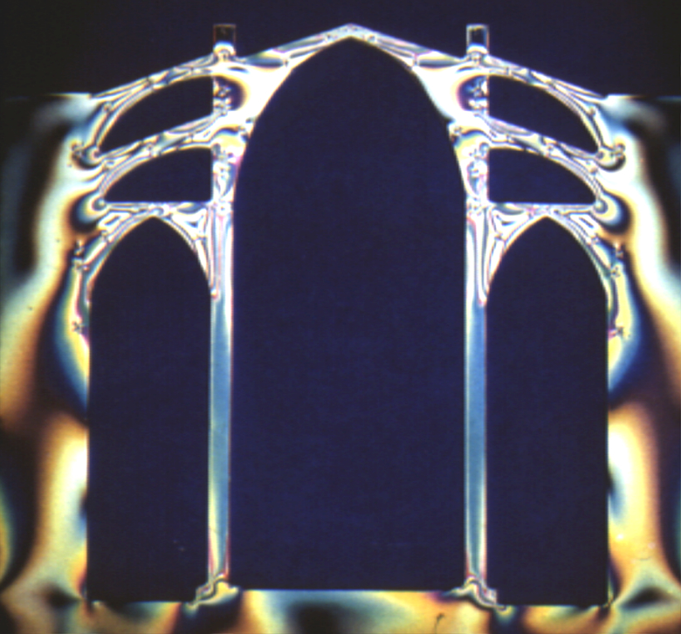
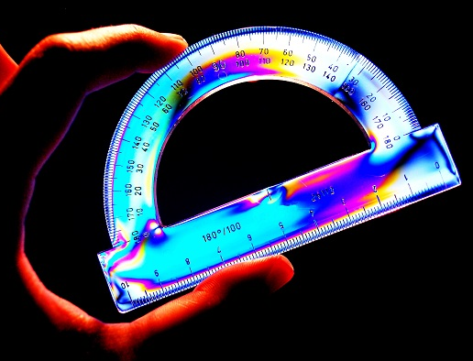

Slide 22
Y
Y
Z
X
X
photocell
P₄
P₃
P₂
P₁
unpolarised light source

Slide 23
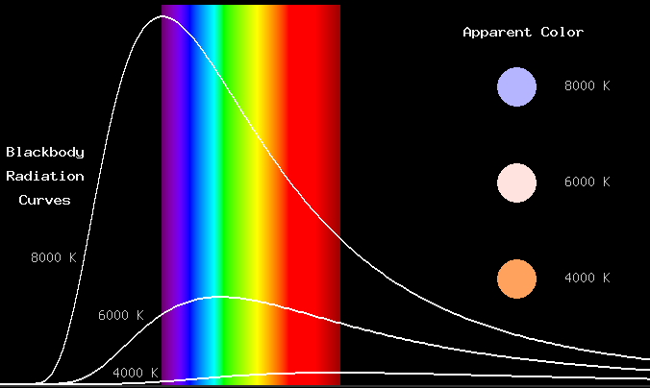
Blackbody Radiation Curves
apparent colour
8000 K
6000 K
8000 K
4000 K
6000 K
4000 K
UV
visible
IR

Slide 24


Slide 25
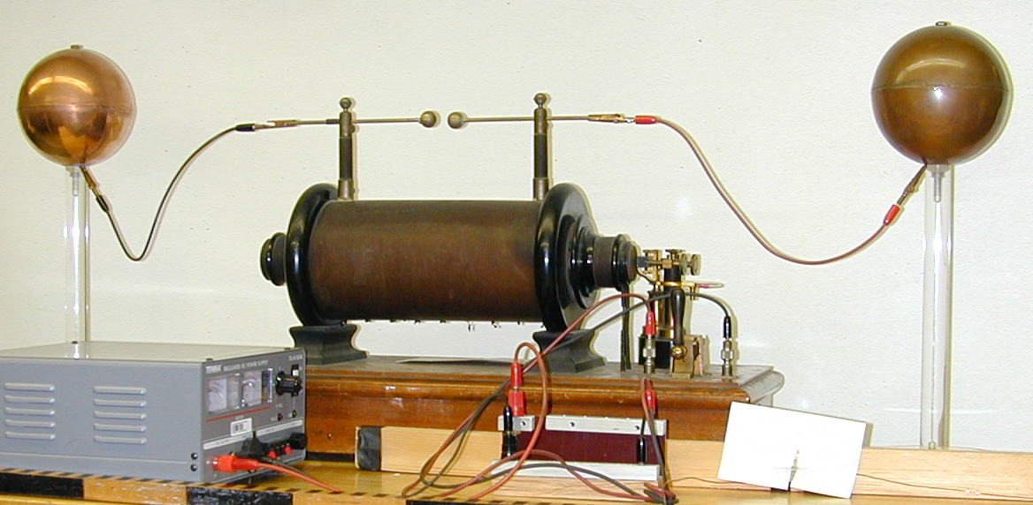
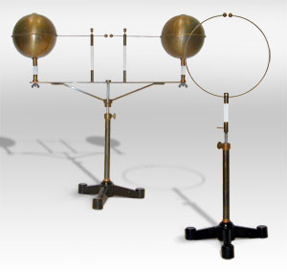

Slide 26
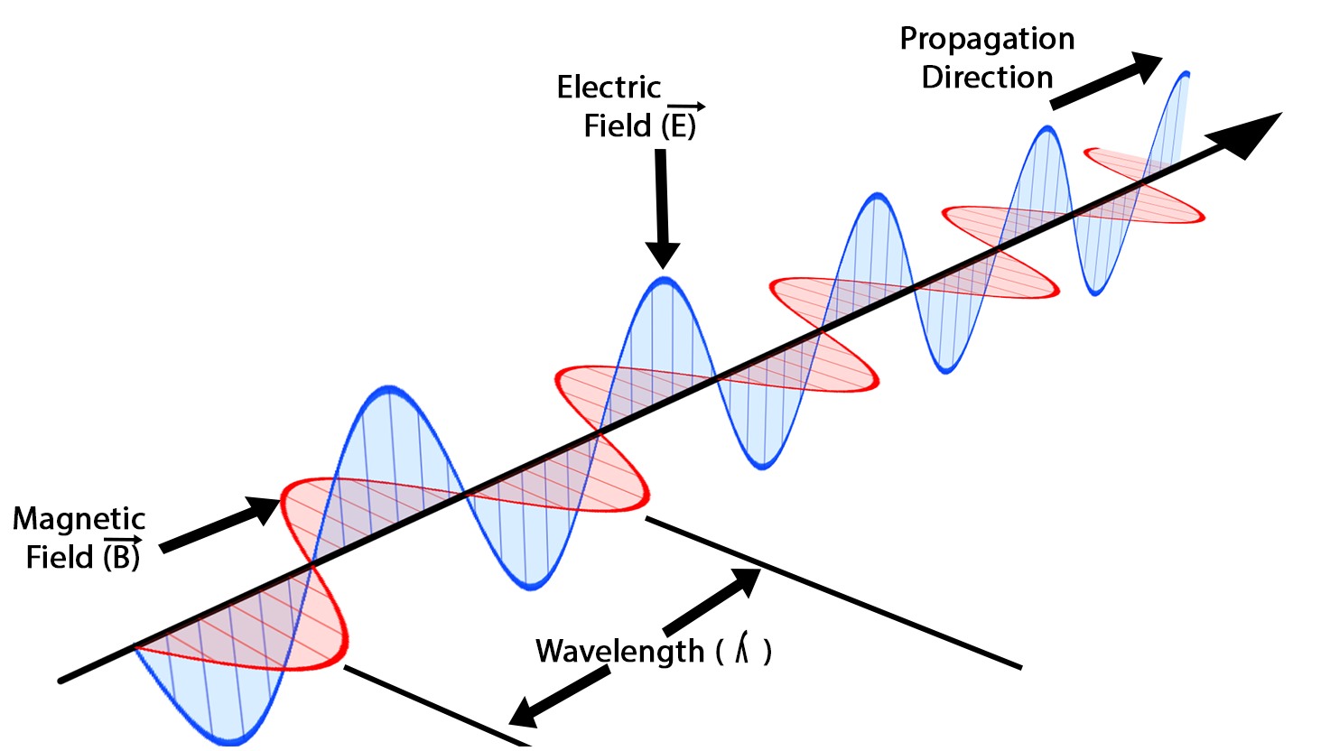

Slide 27
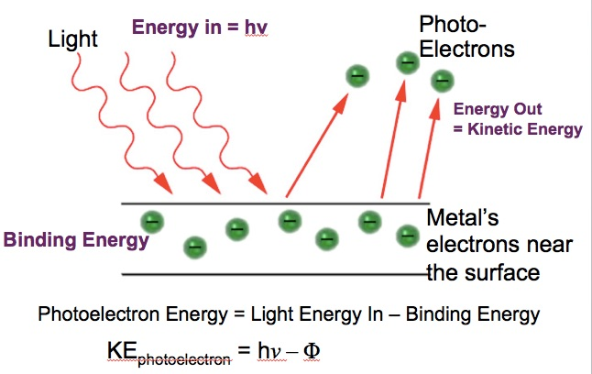
light
photon energy
emitted electrons
energy = KE_{electron}
binding
energy W
metal’s electron
near surface
KE emitted electron =
energy of photon – binding energy
PHOTOELECTRIC EFFECT ⇒ PARTICLE MODEL OF LIGHT

Slide 28
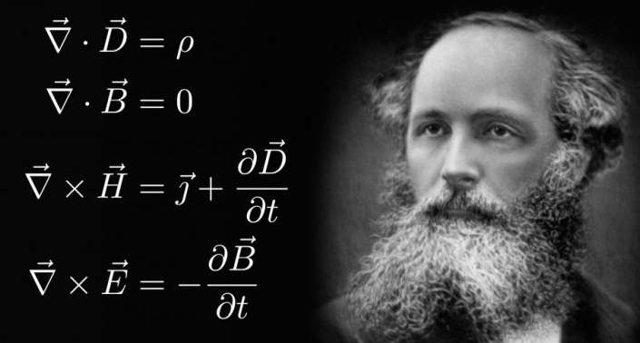
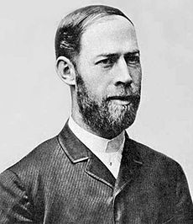
James Clerk Maxwell
Heinrich Hertz

Slide 29
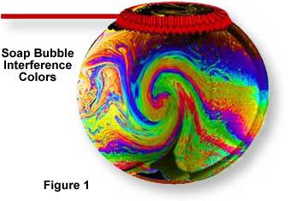
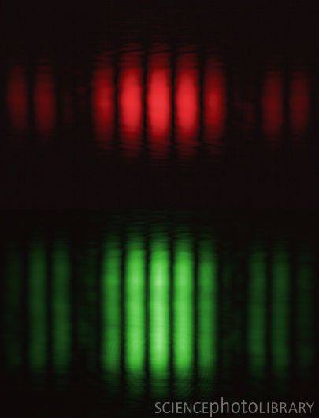
interference of light in a soap bubble
interference patterns of red and green light from a laser
INTERFERENCE ⇒ WAVE MODEL OF LIGHT

